Slide 1
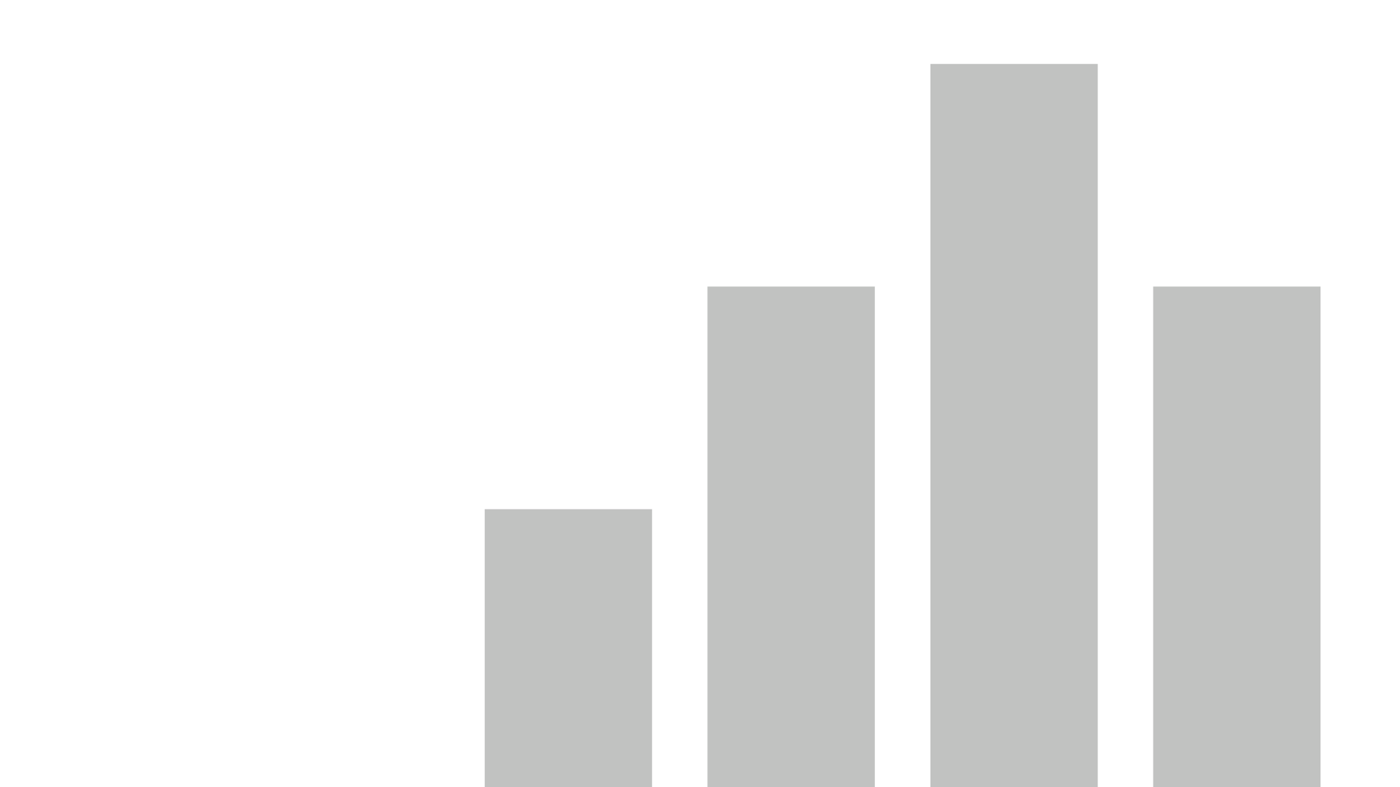


Ibuwums Brewery Plc. _ Oluwatobi Akinwumi
View in Power BI
Last data refresh:
6/19/2025 12:58:11 PM UTC
Downloaded at:
6/19/2025 1:05:04 PM UTC

Slide 2
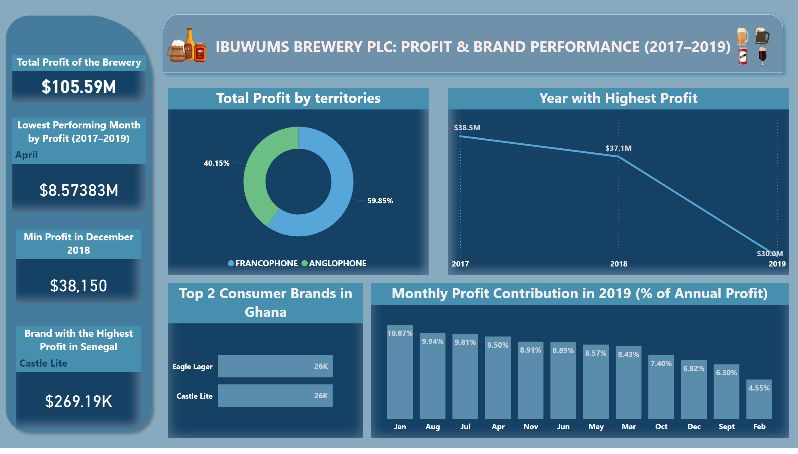
Territories
Notes:
Total Profit of the Brewery
No alt text provided
Total Profit by territories
No alt text provided
Year with Highest Profit
No alt text provided
Lowest Performing Month by Profit (2017–2019)
No alt text provided
Min Profit in December 2018
No alt text provided
Monthly Profit Contribution in 2019 (% of Annual Profit)
No alt text provided
Brand with the Highest Profit in Senegal
No alt text provided
Top 2 Consumer Brands in Ghana
No alt text provided
IBUWUMS BREWERY PLC: Profit & Brand Performance (2017–2019)
No alt text provided
shape
No alt text provided
image
No alt text provided
image
No alt text provided

Slide 3
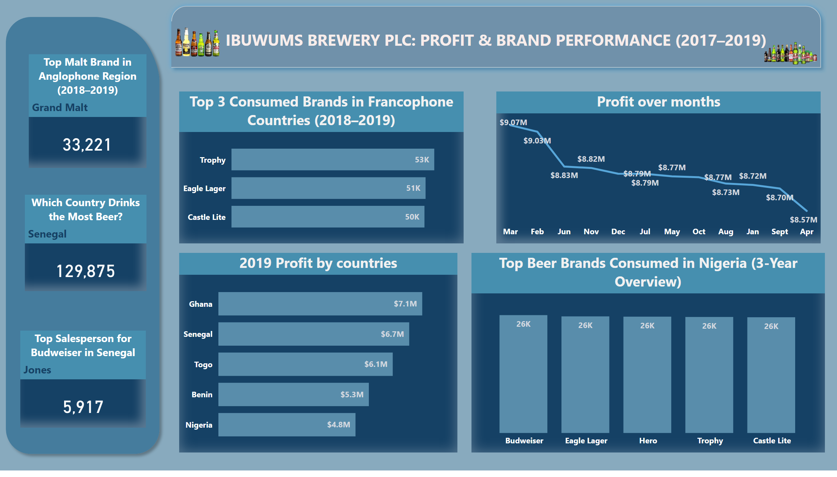
Other countries
Notes:
Profit over months
No alt text provided
Top 3 Consumed Brands in Francophone Countries (2018–2019)
No alt text provided
Top Beer Brands Consumed in Nigeria (3-Year Overview)
No alt text provided
Top Malt Brand in Anglophone Region (2018–2019)
No alt text provided
2019 Profit by countries
No alt text provided
shape
No alt text provided
Which Country Drinks the Most Beer?
No alt text provided
IBUWUMS BREWERY PLC: Profit & Brand Performance (2017–2019)
No alt text provided
image
No alt text provided
image
No alt text provided
Top Salesperson for Budweiser in Senegal
No alt text provided

Slide 4
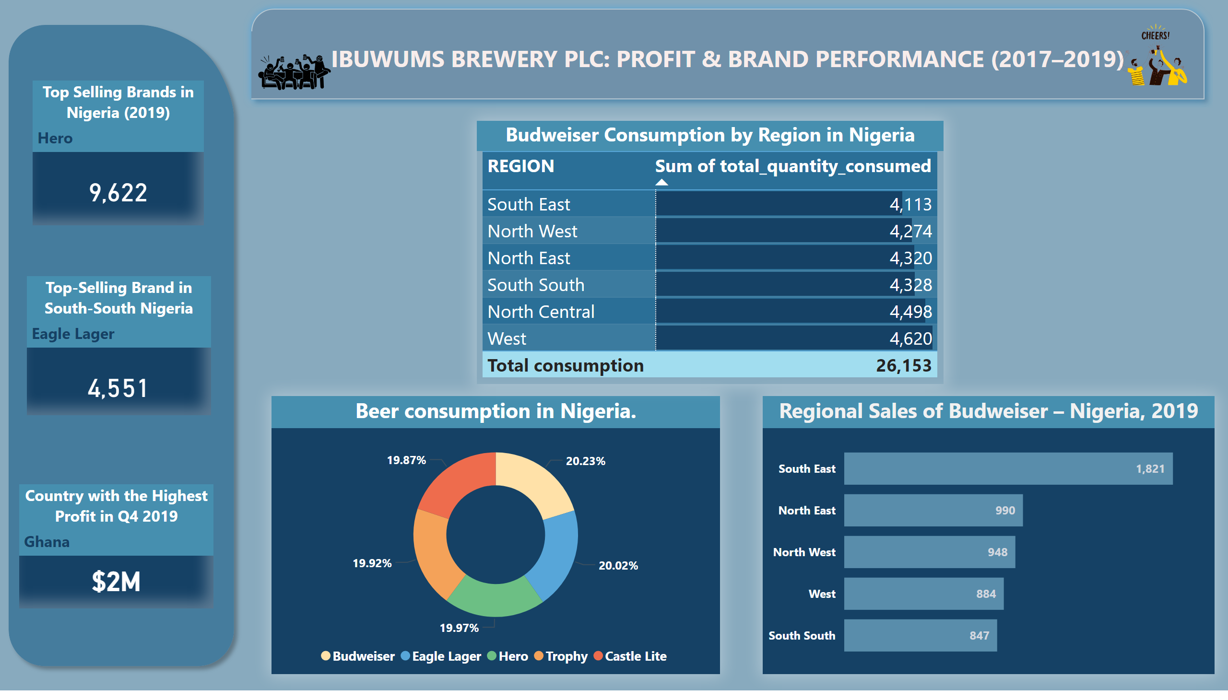
in Nigeria
Notes:
Top-Selling Brand in South-South Nigeria
No alt text provided
Beer consumption in Nigeria.
No alt text provided
Budweiser Consumption by Region in Nigeria
No alt text provided
Regional Sales of Budweiser – Nigeria, 2019
No alt text provided
Country with the Highest Profit in Q4 2019
No alt text provided
shape
No alt text provided
IBUWUMS BREWERY PLC: Profit & Brand Performance (2017–2019)
No alt text provided
image
No alt text provided
image
No alt text provided
Top Selling Brands in Nigeria (2019)
No alt text provided

